Slide 1

Wellmark Blue Cross and Blue Shield
2025 Iowa Graduate Business Analytics Case Competition

Slide 2





TEAM - 06
Siddarth Gopalakrishnan
Akash Singh
Archana Kanuri
Gabriela Rosa
Akash Singh
Gaby Rosa
Data Analyst
Business Analyst
Data Engineer
Project Manager

Slide 3
48.9%
$2.6B
Increase in Iowa's dual-eligible population since 2020
Estimated increase in Medicaid costs by 2030 if current trend continues

Slide 4




Wellmark Case Overview
Mission
The Business Challenge
Championing accessible, affordable and sustainable healthcare for Iowans and South Dakotans
Dual Eligibility Surge
A growing number of individuals are aging into Medicare and simultaneously qualifying for Medicaid due to low income or disability.
Scale
Serving +2M members with 39,000+ in network providers.
Economic Strain
Rising healthcare cost + stagnant wages = growing Medicaid dependence
Focus
System Pressures
Improving community health and advancing health equity
Aging population + rural access gaps are stretching provider capacity.
Case
Overview
Executive Summary
Data & Methodology
Key Insights
Conclusions
Recommendations
Notes:
Explain our understanding of optimal workforce and successful operational facility and our approach of it as a balance between two.

Slide 5
Medicare & Medicaid
Feature | Medicare | Medicaid | Dual-Eligible
Hospital & Doctor Visits | Covered (Parts A & B) | Covered | Covered
Prescription Drugs | Part D (extra cost) | Covered | Enhanced via Extra Help
Dental, Vision, Hearing | Limited | Often included | Expanded under Medicaid
Long-Term Care | Limited | Yes | Yes
Premium Help | No | N/A | Medicaid pays Medicare premiums
Copay/Coinsurance Help | No | N/A | Medicaid reduces/eliminates out-of-pocket costs
Case
Overview
Executive Summary
Data & Methodology
Key Insights
Conclusions
Recommendations
Notes:
Moving to the survey results data we have looked we have figure out the favorable responses are below thr benchmarks and they slightly descreased compared to previous year and unfavorable slightly increase.

Slide 6
Problem Statement & Action Plan
Post-COVID, dual-eligible enrollment has surged—driven by economic hardship, aging, and policy changes—creating a key challenge for Wellmark: managing healthcare strain, funding sustainability, and growing health disparities.
Problem Statement
Executive Summary
Data & Methodology
Key Insights
Conclusions and Recommendations
Action
Plan
Concise, data-driven overview of our findings and approach
Identify analytical approach and modeling techniques
Noticeable findings relevant to dual-elegible populations
Evidence-based strategies to reduce system strain and disparities.
Case
Overview
Executive Summary
Data & Methodology
Key Insights
Conclusions
Recommendations
Notes:
Our approach to define this balance:
Explain what influences
Compare models to define optimal balance
Create dashboar for monitoring afterwords
And we provide recommendations based on these

Slide 7
Executive Summary

Slide 8
Healthcare System & Funding
Challenge | Strategic Recommendation | Operational Feasibility
Increased pressure on hospitals and doctors due to rising dual-eligible volume (e.g., chronic conditions, ER usage, capacity issues) | Expand Home-Based & Telehealth Models for duals to reduce preventable hospitalizations (especially in rural areas) | Uses existing telehealth infrastructure and mobile NP programs
Rising Medicare spending per dual-eligible threatening program sustainability | Risk-Stratified Funding Models that allocate higher per-capita funding only to high-need duals, using predictive analytics | Can be integrated into provider contracts (e.g., ACOs, DSNPs)
Administrative overload on providers due to dual compliance systems (Medicare + Medicaid) | Create Unified Dual Eligibility Administrative Hubs at regional level to streamline enrollment, billing & case management | Reduces documentation and billing errors
Case
Overview
Executive Summary
Data & Methodology
Key Insights
Conclusions
Recommendations
Notes:
Moving to the survey results data we have looked we have figure out the favorable responses are below thr benchmarks and they slightly descreased compared to previous year and unfavorable slightly increase.

Slide 9
Geographic & Sociographic Trends in Dual Eligibility
Challenge | Observations | Strategic Recommendations
Correlations exist within the population demographics | Strong correlations with the following variables: Education, Disabilty, Age, health uninsured and rent burden and race native. | • Use AI to segment and personalize outreach based on demographics • Expand telehealth access with free tech training kits • Offer targeted wellness incentives based on socioeconomic profiles
How have dual-eligible populations evolved? | Steady growth for total and partial duality in both states. Counties like Hyde, Adams, Ziebach, and Jerauld experienced sharp year-over-year spikes (sometimes over 20%) in dual eligibility. Counties like Todd (38%), Oglala Lakota (36%), and Buffalo (35%) have the highest percentages of dual-eligible residents. Unlike South Dakota’s strong tribal-area concentration, Iowa's dual-eligible population is more evenly distributed, with a flatter gradient of need. | • Incentivize fitness and wellness through gamified mobile apps. • Provide wellness program participation rewards • Deploy AI monitoring dashboards to track regional growth and trends
How are these trends contributing to the increase in dual eligibility? | Many counties with high or rising dual eligibility (Todd, Ziebach, Wapello, Appanoose) have older populations and limited local job markets. Counties on Native American reservations show the highest shares—up to 38% dual eligibility. In rural counties with provider shortages, people are more likely to delay care until conditions worsen | • Fund rural medical workforce through scholarships and loan forgiveness. • Use AI-based triage/chatbots to reduce care delays. • Develop inter-county branded wellness and fitness challenges.
Case
Overview
Executive Summary
Data & Methodology
Key Insights
Conclusions
Recommendations
Notes:
Moving to the survey results data we have looked we have figure out the favorable responses are below thr benchmarks and they slightly descreased compared to previous year and unfavorable slightly increase.

Slide 10
Economic & Policy Impact on Medicaid Eligibility
Challenge | Strategic Recommendation | Operational Feasibility
Rising Inflation & Wage Stagnation More people falling below Medicaid income thresholds due to economic pressure. | Dynamic Eligibility Indexing Tie Medicaid eligibility thresholds to cost-of-living adjustments (COLA) at the regional level. | Uses existing income data + inflation metrics.
Job Loss and Shrinking Workforce Participation Drives up Medicaid reliance as employer-sponsored coverage drops | Medicaid Extension for Gig & Informal Workers Offer subsidized Medicaid-like plans for part-time/contract workers with no benefits. | Can use ACA exchanges or expanded Medicaid waivers.
Case
Overview
Executive Summary
Data & Methodology
Key Insights
Conclusions
Recommendations
Notes:
Moving to the survey results data we have looked we have figure out the favorable responses are below thr benchmarks and they slightly descreased compared to previous year and unfavorable slightly increase.

Slide 11
Data & Methodology

Slide 12
Data & Methodology
Datasets used
Modeling Techniques:
Descriptive Analytics: County + ZIP-level summary statistics.
Clustering: KMeans to group counties by demographic & healthcare profile.
Ridge and Linear Regression: Identify standardized feature importance for dual eligibility prediction.
PCA (Principal Component Analysis): Reduce dimensionality and visualize relationships
Geospatial Mapping: Visualize clusters, shortage areas, and ZIP risk profiles
Main Datasets Used:
Medicare Enrollment Data
ZIP-Level Socioeconomic Data
Secondary Datasets:
CMS Program Statistics -
Medicare Total Enrollment |
Medicare-Medicaid Dual Enrollment |
CMS Data Medicare Advantage
Geographic Variation - National & State |
CMS Data Medicaid Contracts and
Rates | Health & Human Services
Case
Overview
Executive Summary
Data & Methodology
Key Insights
Conclusions
Recommendations
Notes:
Explain our understanding of optimal workforce and successful operational facility and our approach of it as a balance between two.

Slide 13
Key Insights: Healthcare System & Funding Challenges

Slide 14
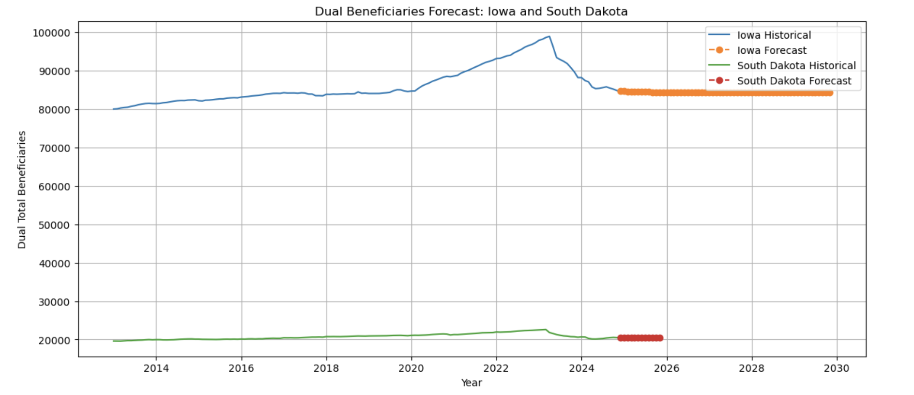
Dual Beneficiaries Forecast
Case
Overview
Executive Summary
Data & Methodology
Key Insights
Conclusions
Recommendations
Notes:
The highest peaks in efficiency is lowest in quality and visa versa.

Slide 15
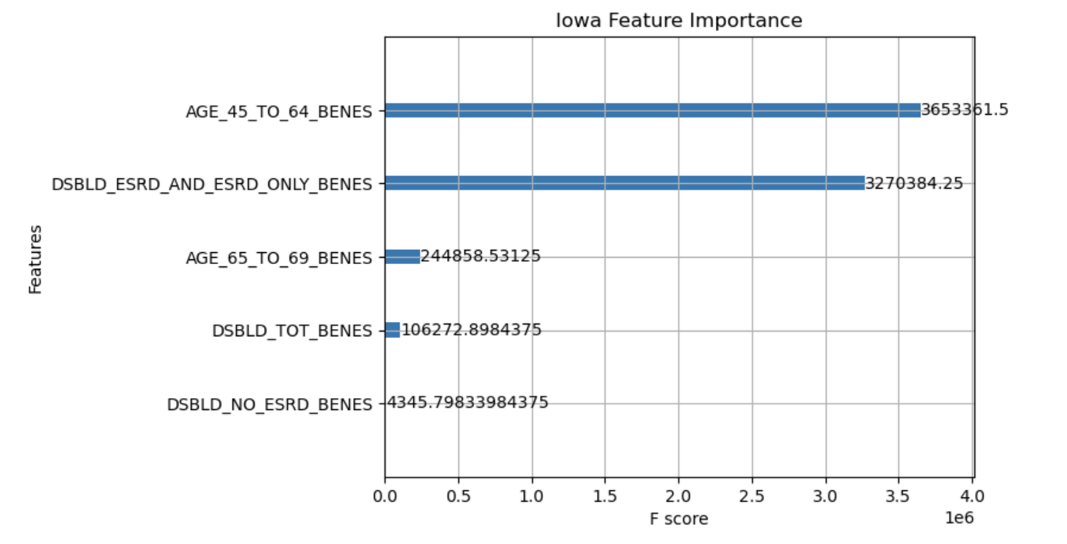
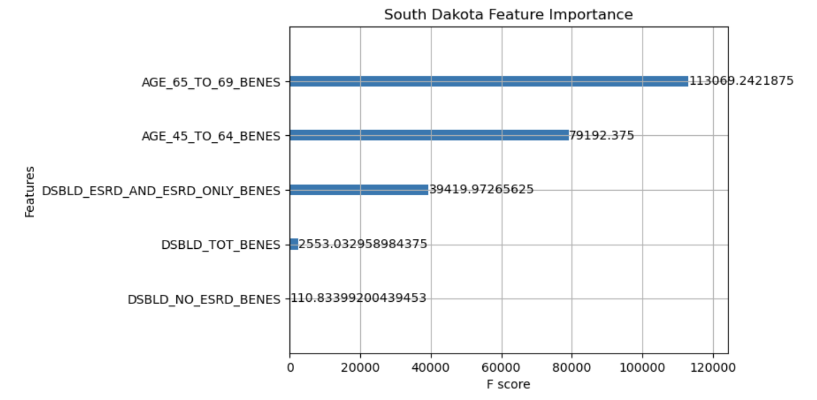
Features Driving - Dual Beneficiaries Forecast
Case
Overview
Executive Summary
Data & Methodology
Key Insights
Conclusions
Recommendations
Notes:
The highest peaks in efficiency is lowest in quality and visa versa.

Slide 16
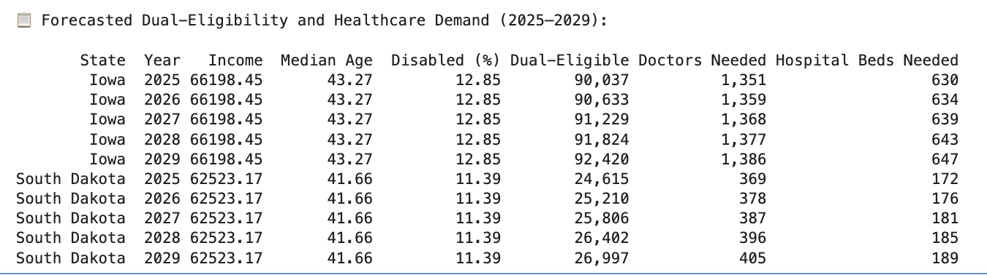
Additional Demands on Hospitals & Doctors
Case
Overview
Executive Summary
Data & Methodology
Key Insights
Conclusions
Recommendations
Notes:
The highest peaks in efficiency is lowest in quality and visa versa.

Slide 17
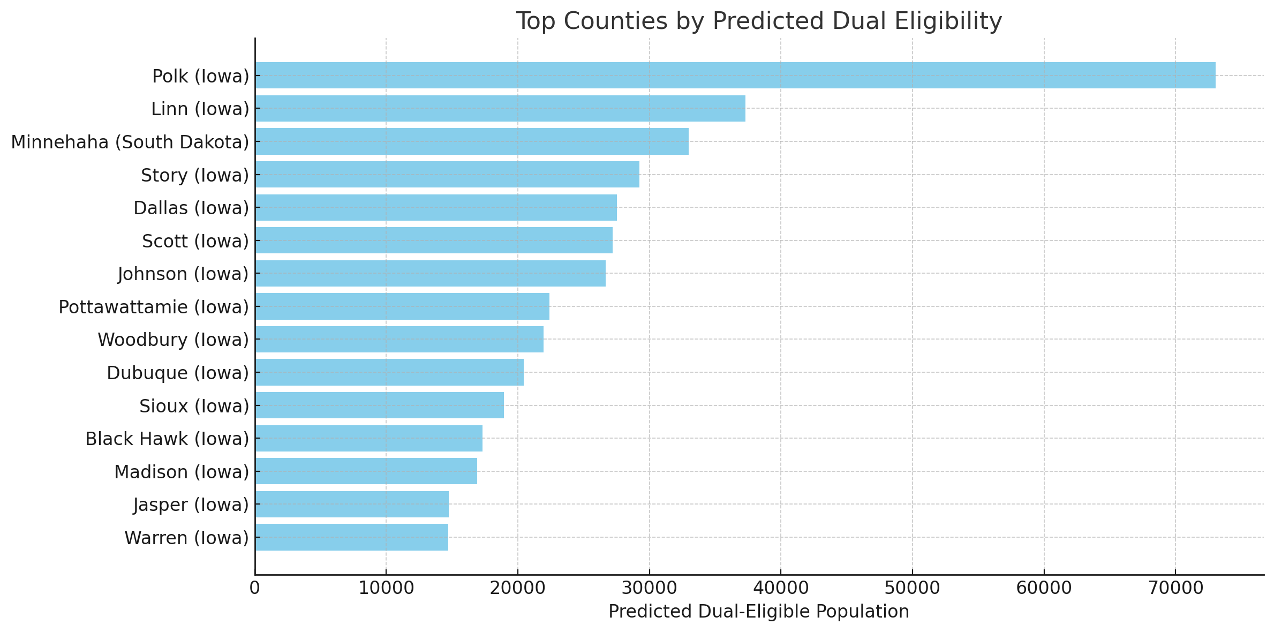
Top Counties by Predicted Dual Eligibility
Case
Overview
Executive Summary
Data & Methodology
Key Insights
Conclusions
Recommendations
Notes:
The highest peaks in efficiency is lowest in quality and visa versa.

Slide 18
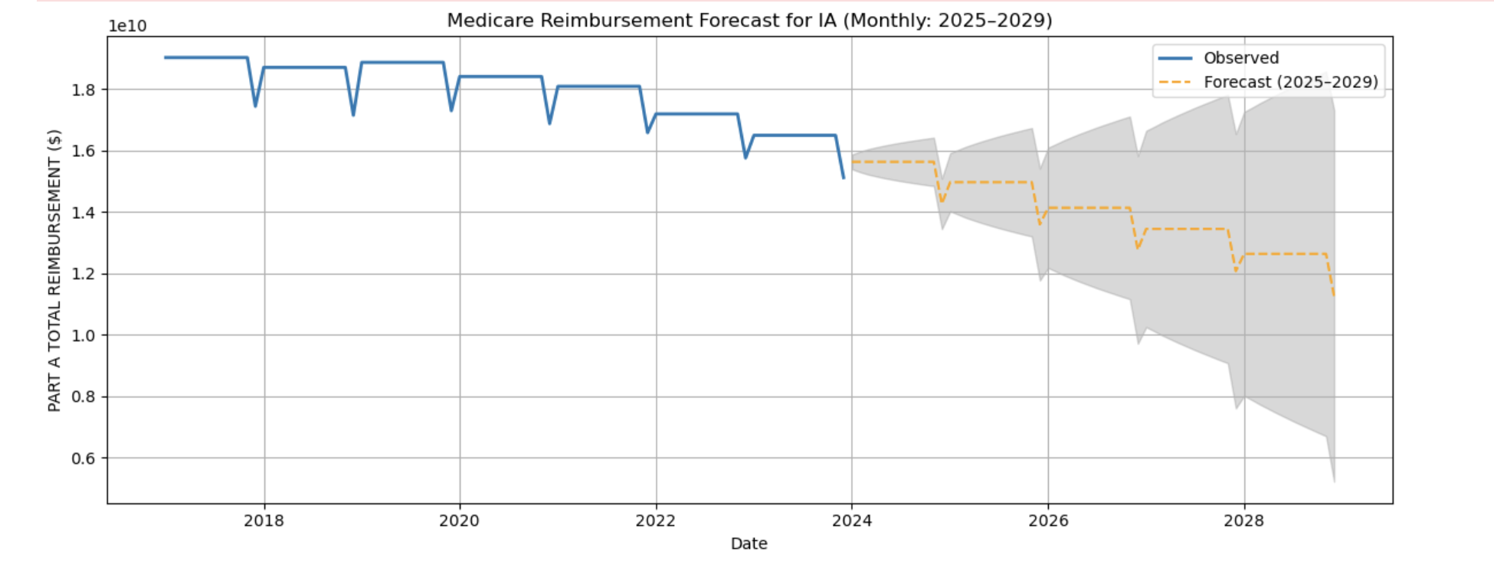
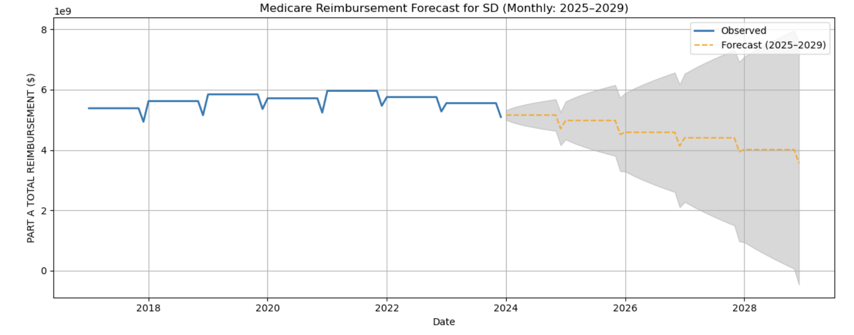
Predicting - Additional Medicare Funding Need Part A
Iowa
South Dakota
Aspect | Iowa (IA) | South Dakota (SD)
Forecast Trend | Gradual decline | Slight decline
Total Reimbursements | Higher overall | Lower overall
Seasonality | Strong and consistent | Strong and consistent
Uncertainty | Moderate and decreasing | low and decreasing
Planning Implication | Gradual adjustment possible | Need contingency strategies
Case
Overview
Executive Summary
Data & Methodology
Key Insights
Conclusions
Recommendations
Notes:
The highest peaks in efficiency is lowest in quality and visa versa.

Slide 19
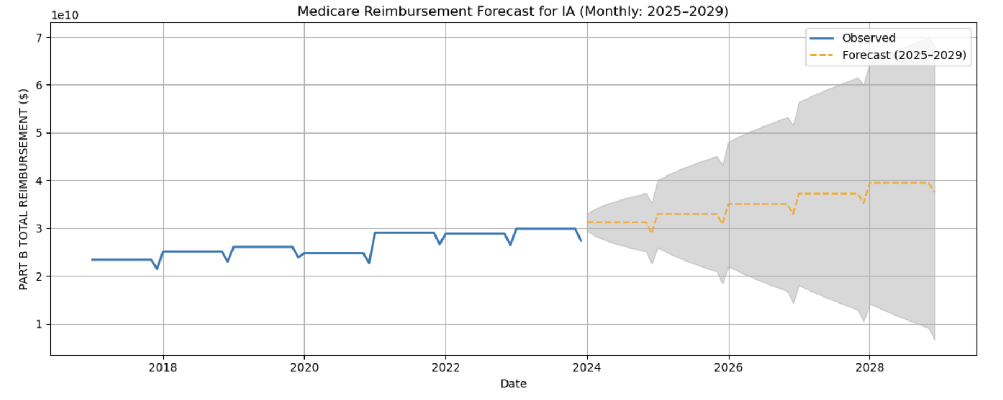
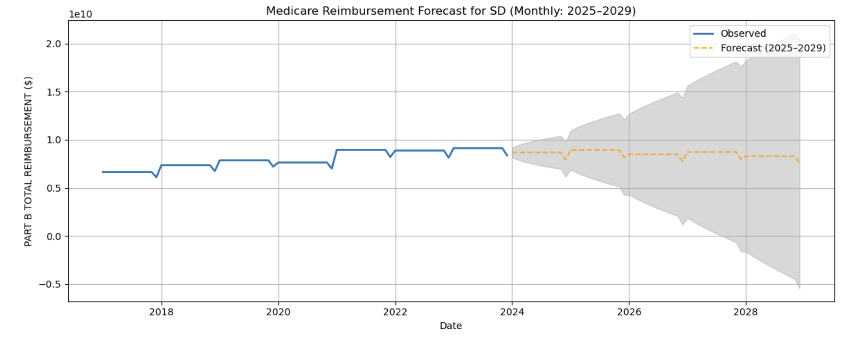
Predicting - Additional Medicare Funding Need Part B
Iowa
South Dakota
Aspect | Iowa (IA) | South Dakota (SD)
Forecast 2025–2029 | Gradual rise (~4B/mo by 2029) | Flat to slight growth (~9M/year)
Uncertainty | Moderate, increases post-2027 | Higher, especially post-2026
Implication | Prepare for funding growth and variability | Monitor for stability; avoid over-reliance on projections
Storyline | Growth-driven by policy/population | Stable Medicare landscape
Case
Overview
Executive Summary
Data & Methodology
Key Insights
Conclusions
Recommendations
Notes:
The highest peaks in efficiency is lowest in quality and visa versa.

Slide 20
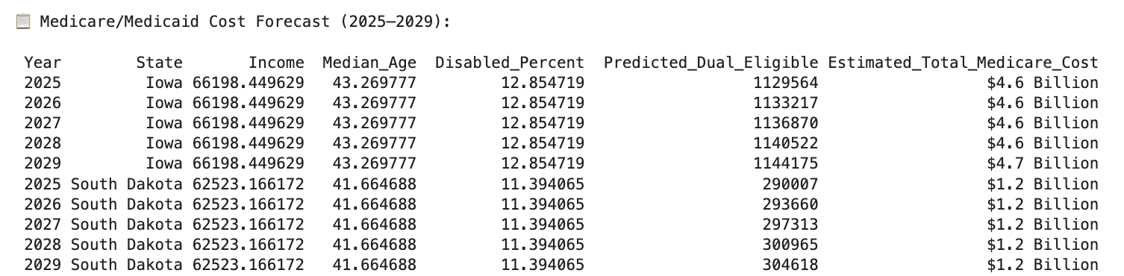
Cost Forecast for Dual-Eligible
Case
Overview
Executive Summary
Data & Methodology
Key Insights
Conclusions
Recommendations
Notes:
The highest peaks in efficiency is lowest in quality and visa versa.

Slide 21
Key Insights: Geographic & Sociographic Trends in Dual Eligibility

Slide 22
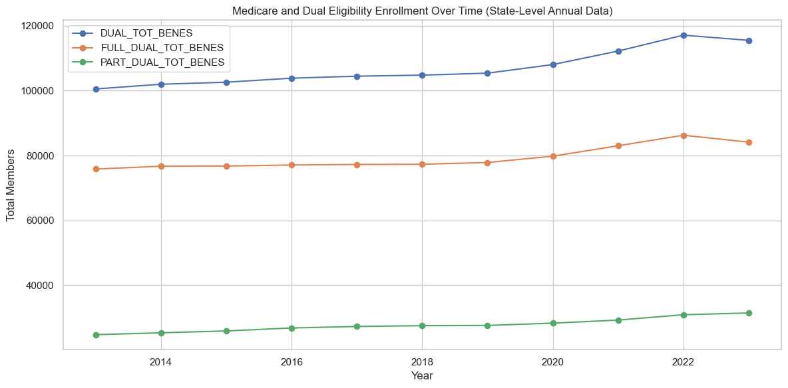
Geographic & Sociographic Trends in Dual Eligibility
Dual Elegibility Enrollment Over Time
Case
Overview
Executive Summary
Data & Methodology
Key Insights
Conclusions
Recommendations
Notes:
The highest peaks in efficiency is lowest in quality and visa versa.

Slide 23
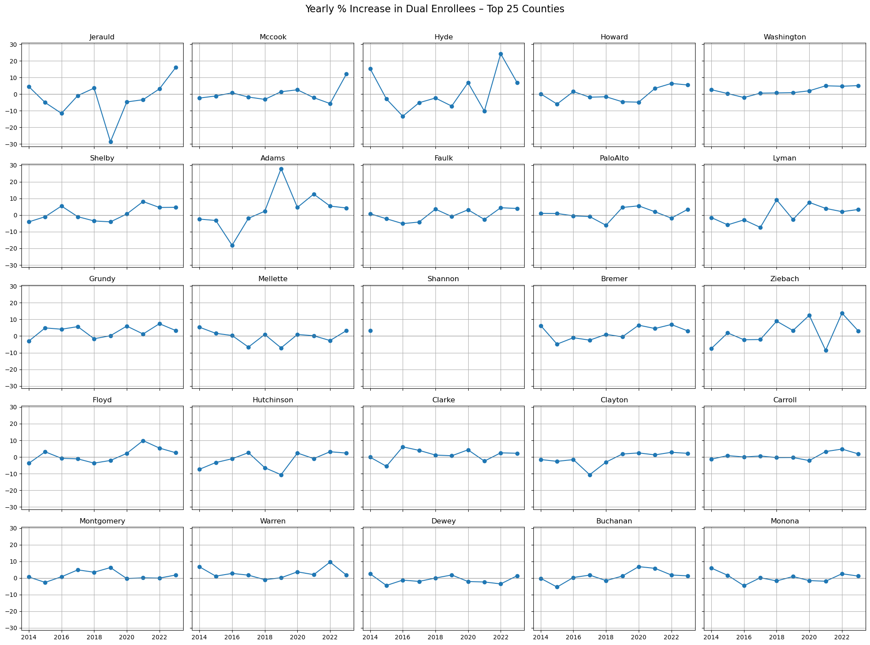
Geographic & Sociographic Trends in Dual Eligibility
Top 25 Counties
Dual Elegibility
Yearly % Increase
Case
Overview
Executive Summary
Data & Methodology
Key Insights
Conclusions
Recommendations
Notes:
The highest peaks in efficiency is lowest in quality and visa versa.

Slide 24
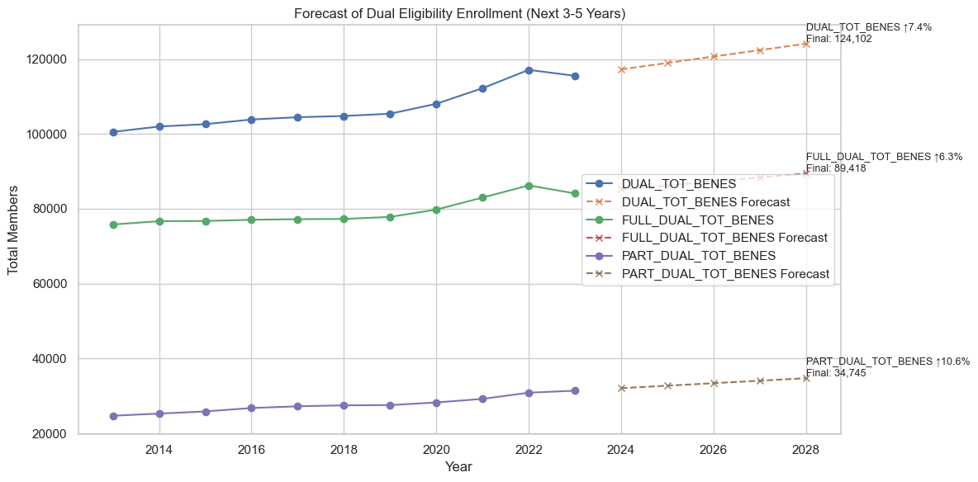
Geographic & Sociographic Trends in Dual Eligibility
Dual Elegibility Enrollment Forecast
Case
Overview
Executive Summary
Data & Methodology
Key Insights
Conclusions
Recommendations
Notes:
The highest peaks in efficiency is lowest in quality and visa versa.

Slide 25
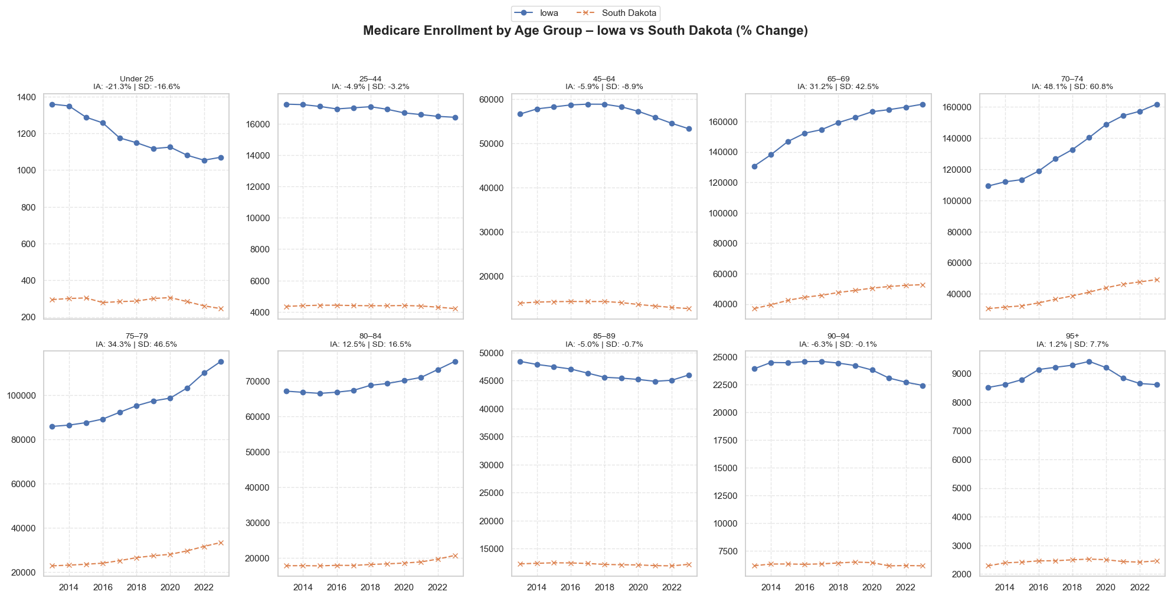
Geographic & Sociographic Trends in Dual Eligibility
Iowa
South Dakota
Case
Overview
Executive Summary
Data & Methodology
Key Insights
Conclusions
Recommendations
Notes:
The highest peaks in efficiency is lowest in quality and visa versa.

Slide 26
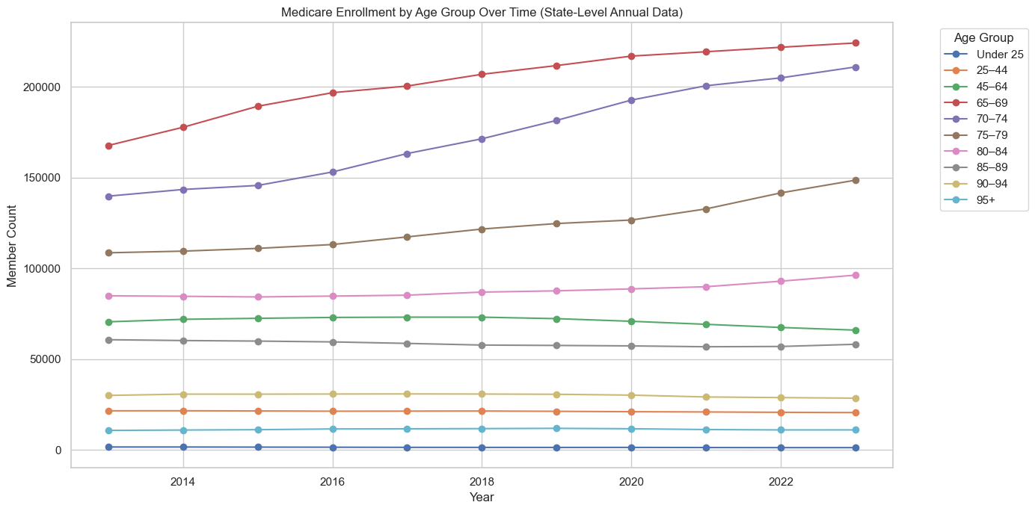
Geographic & Sociographic Trends in Dual Eligibility
Medicare Enrollment by Age Group
Case
Overview
Executive Summary
Data & Methodology
Key Insights
Conclusions
Recommendations
Notes:
The highest peaks in efficiency is lowest in quality and visa versa.

Slide 27
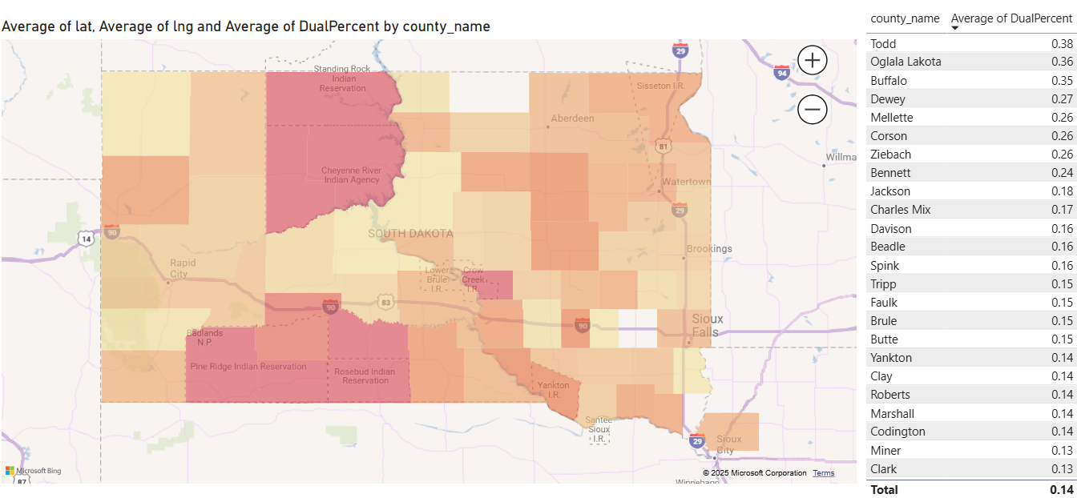
Geographic & Sociographic Trends in Dual Eligibility
South Dakota Counties with the Highest Share of Dual-Eligible Medicare Members
Counties like Todd (38%), Oglala Lakota (36%), and Buffalo (35%) have the highest percentages of dual-eligible residents, these are also counties on Native American reservations.
Central counties like Dewey, Mellette, Corson, and Ziebach also show elevated rates (26–27%), reinforcing the trend that rural and reservation areas face higher dual-eligibility needs.
Case
Overview
Executive Summary
Data & Methodology
Key Insights
Conclusions
Recommendations
Notes:
The highest peaks in efficiency is lowest in quality and visa versa.

Slide 28
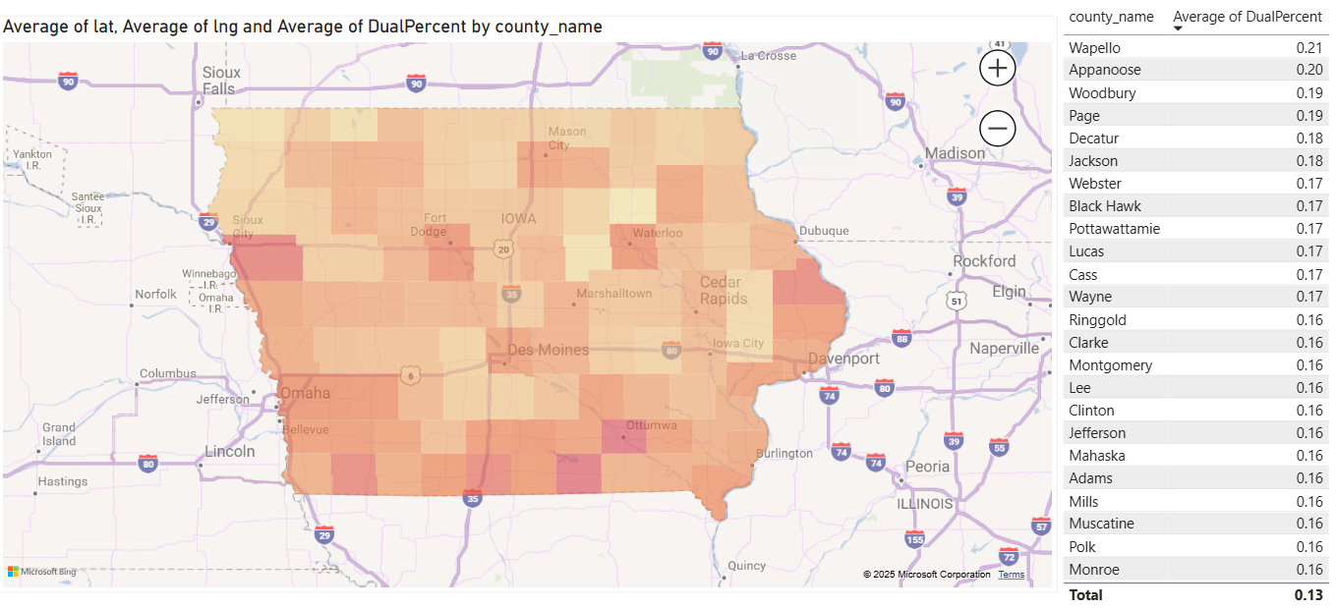
Geographic & Sociographic Trends in Dual Eligibility
Iowa Counties with the Highest Share of Dual-Eligible Medicare Members
Highest dual-eligible shares are:
Wapello (21%)
Appanoose (20%)
Woodbury, Page (19%)
In contrast, South Dakota’s top counties (Todd, Oglala Lakota, Buffalo) range from 35–38%, showing much higher concentrations—especially in tribal and rural regions.
Higher shares are mostly seen in:
Southern counties near Missouri (Wapello, Appanoose, Decatur, Page)
Urban or semi-urban counties with lower socioeconomic indicators (Woodbury [Sioux City], Black Hawk [Waterloo])
Case
Overview
Executive Summary
Data & Methodology
Key Insights
Conclusions
Recommendations
Notes:
The highest peaks in efficiency is lowest in quality and visa versa.

Slide 29
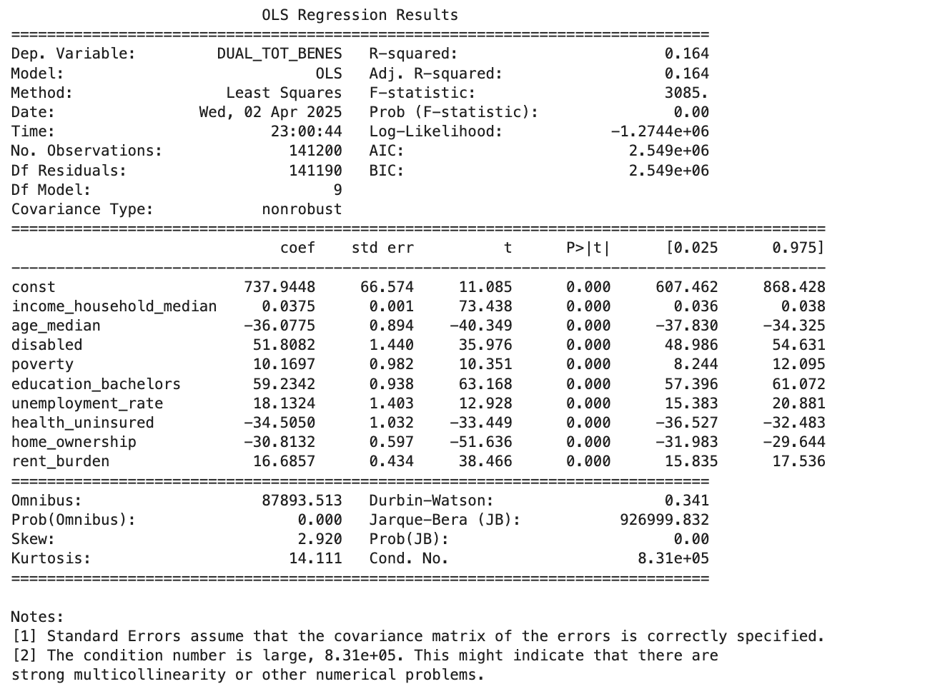
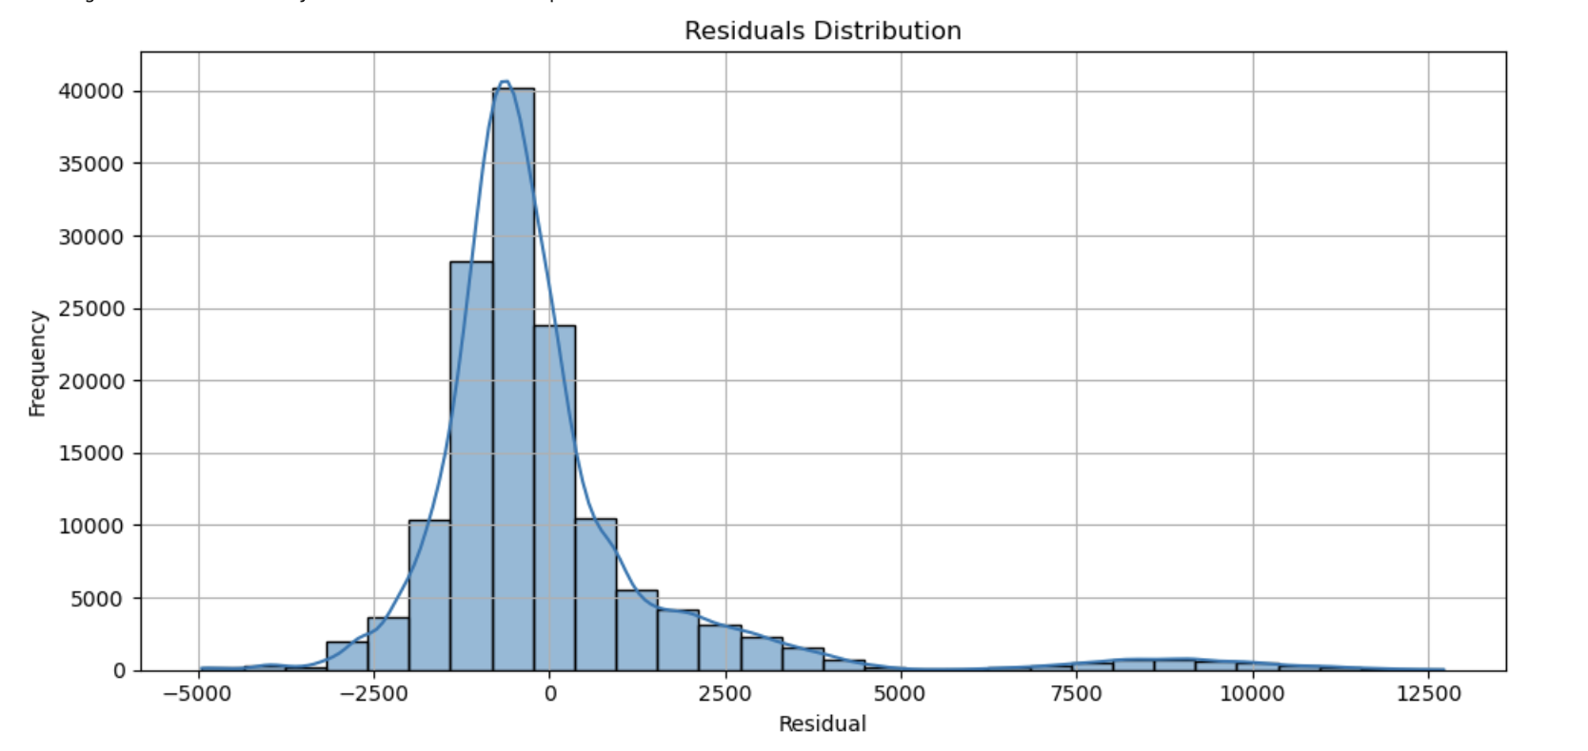
Geographic & Sociographic Trends in Dual Eligibility
Regression: Dual Eligibility vs Demographics
Case
Overview
Executive Summary
Data & Methodology
Key Insights
Conclusions
Recommendations
Notes:
The highest peaks in efficiency is lowest in quality and visa versa.

Slide 30
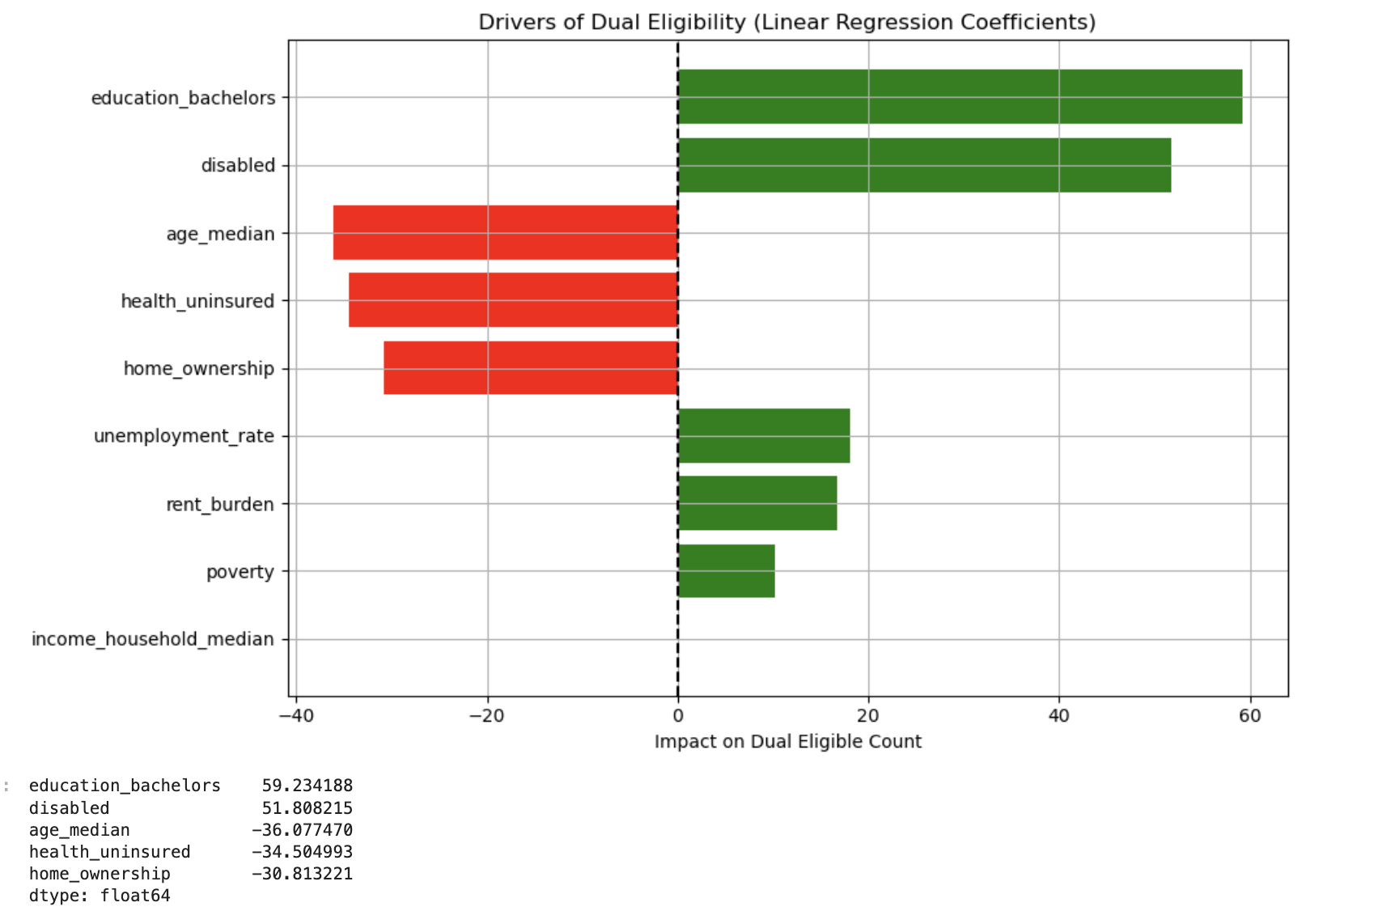
Geographic & Sociographic Trends in Dual Eligibility
Bar chart of top predictors
Top 5 Demographic Drivers
Education Bachelors: Higher education surprisingly linked with more duals — likely due to urban areas with both education and low-income seniors.
Disability is a strong positive driver. more disabilities → more duals
Age Median: Older areas slightly less dual — may be due to stable Medicare-only coverage.
Health uninsured: Less public coverage → fewer duals.
Rent-heavy areas → more duals.
Case
Overview
Executive Summary
Data & Methodology
Key Insights
Conclusions
Recommendations
Notes:
The highest peaks in efficiency is lowest in quality and visa versa.

Slide 31
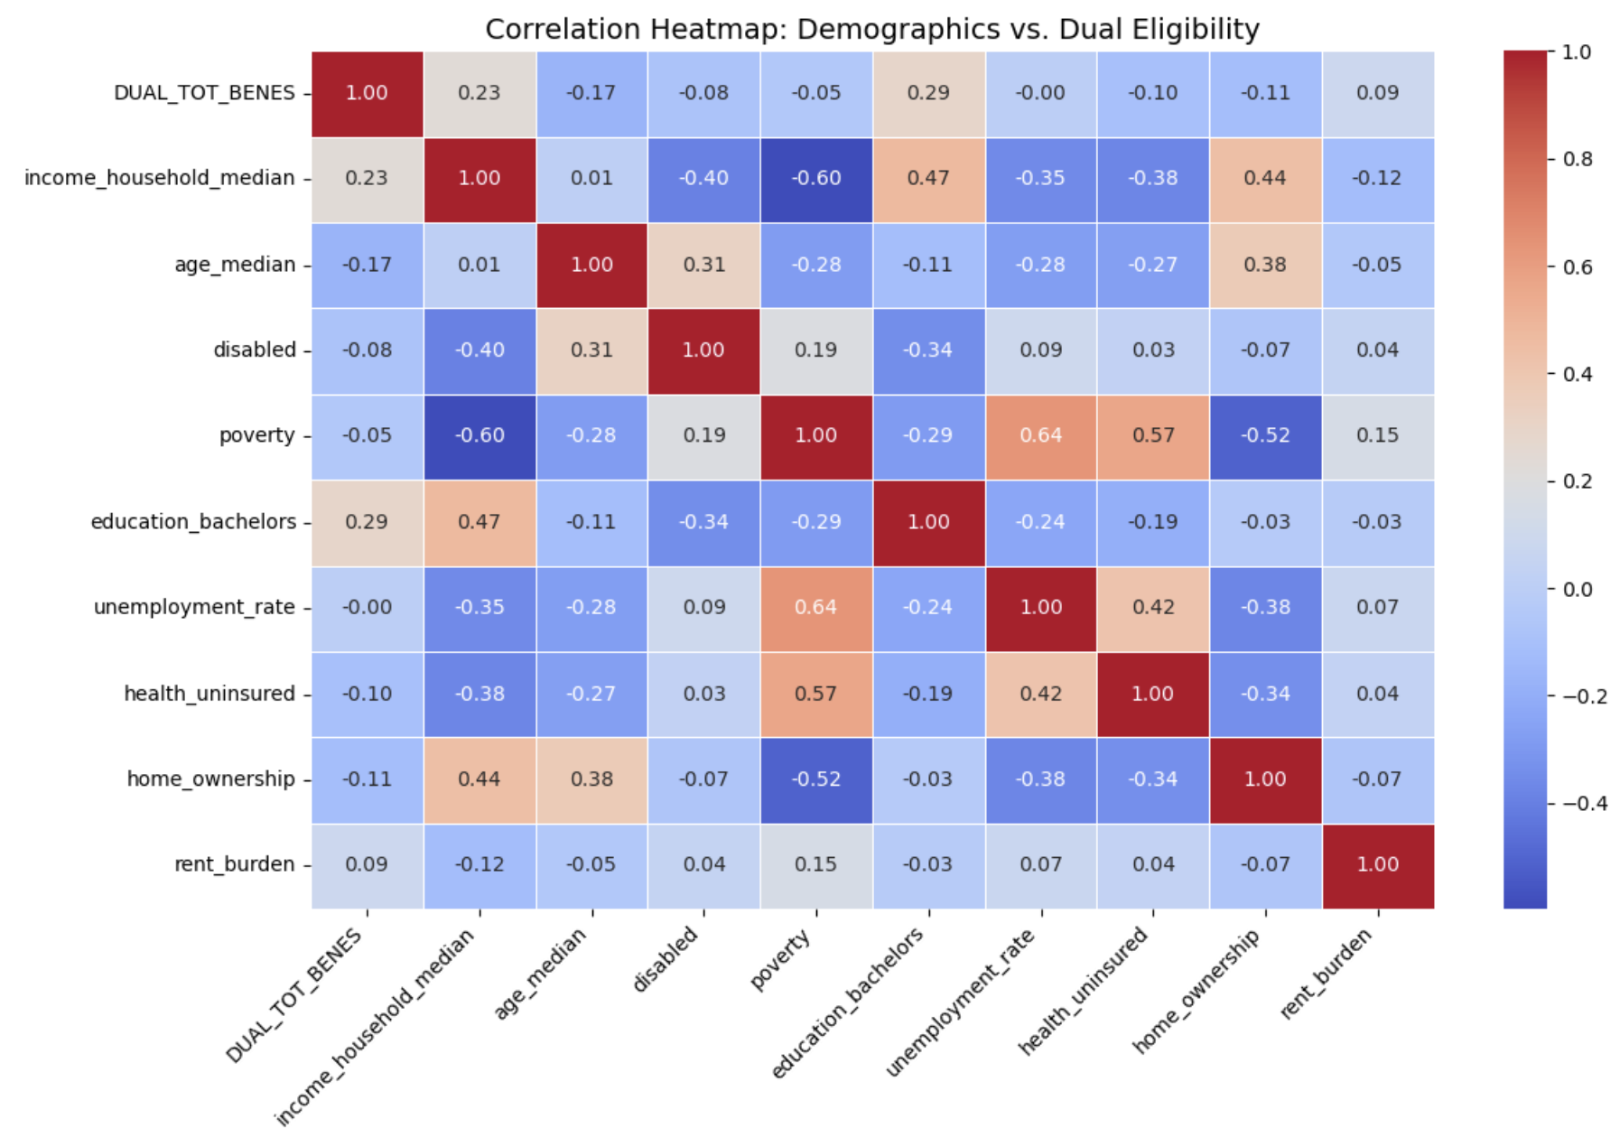
Geographic & Sociographic Trends in Dual Eligibility
Heatmap: Dual Elibility vs Demographics
Significant Correlation
Education Bachelors
Age Median
Positive Correlation
Income household median
Education Bachelors
Rent Burden
Negative Correlation
Health uninsured
Home Ownership
Case
Overview
Executive Summary
Data & Methodology
Key Insights
Conclusions
Recommendations
Notes:
The highest peaks in efficiency is lowest in quality and visa versa.

Slide 32
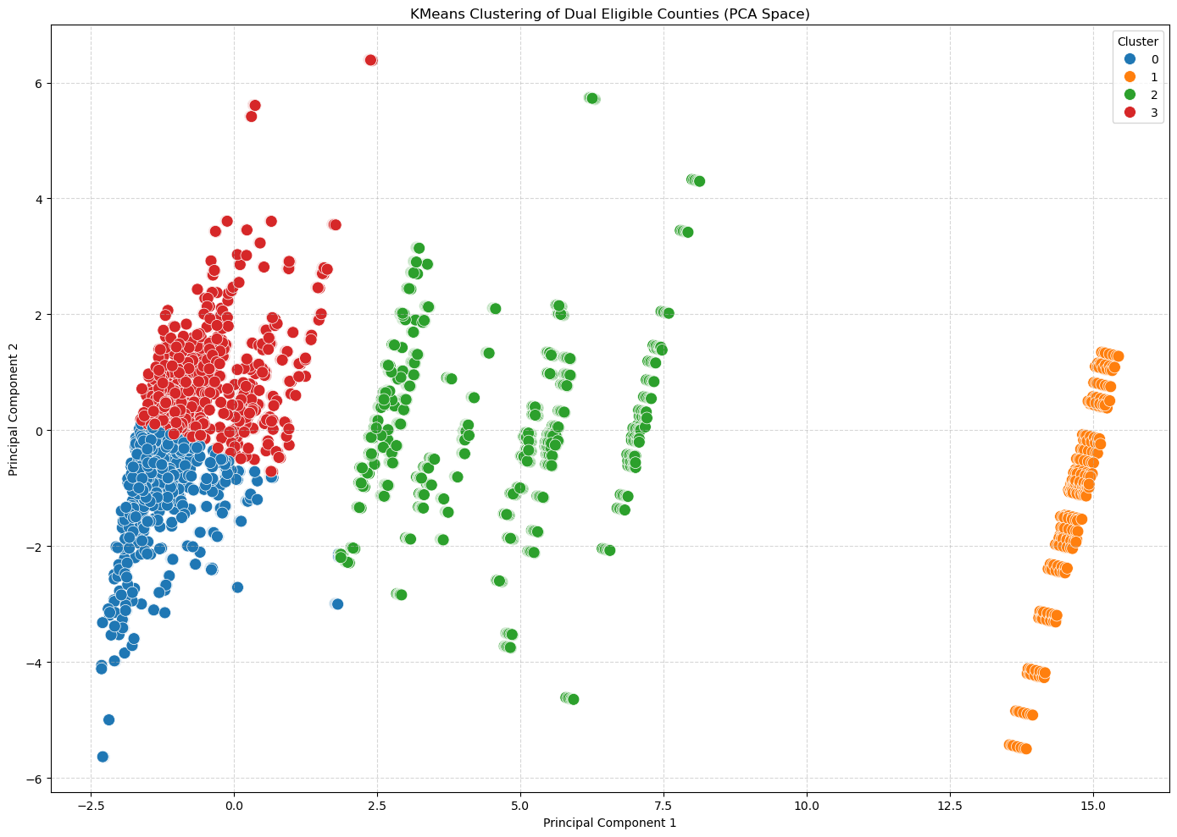
Geographic & Sociographic Trends in Dual Eligibility
Geographic & Clustering
Cluster 0 – Rural Underserved
Lowest income, lowest education (23%)
Lowest access to charity support
Still high dual eligible rate: 0.15
Rural counties likely needing targeted outreach
Cluster 1 – Urban Giant (Polk County)
Massive size
Highest in enrollment, drug use, disability
High dual eligible rate: 0.16
Unique mega-cluster
Cluster 2 – High Income, High Education
Highest median_income
Highest college_rate: 42%
Lowest dual eligible rate: 0.10
Likely affluent urban/suburban counties
Cluster 3 – Mid-Sized Urban Mix
Moderate income & education
Dual eligible rate: 0.15
Case
Overview
Executive Summary
Data & Methodology
Key Insights
Conclusions
Recommendations
Notes:
The highest peaks in efficiency is lowest in quality and visa versa.

Slide 33
Key Insights: Economic & Policy Impact on Medicaid Eligibility

Slide 34
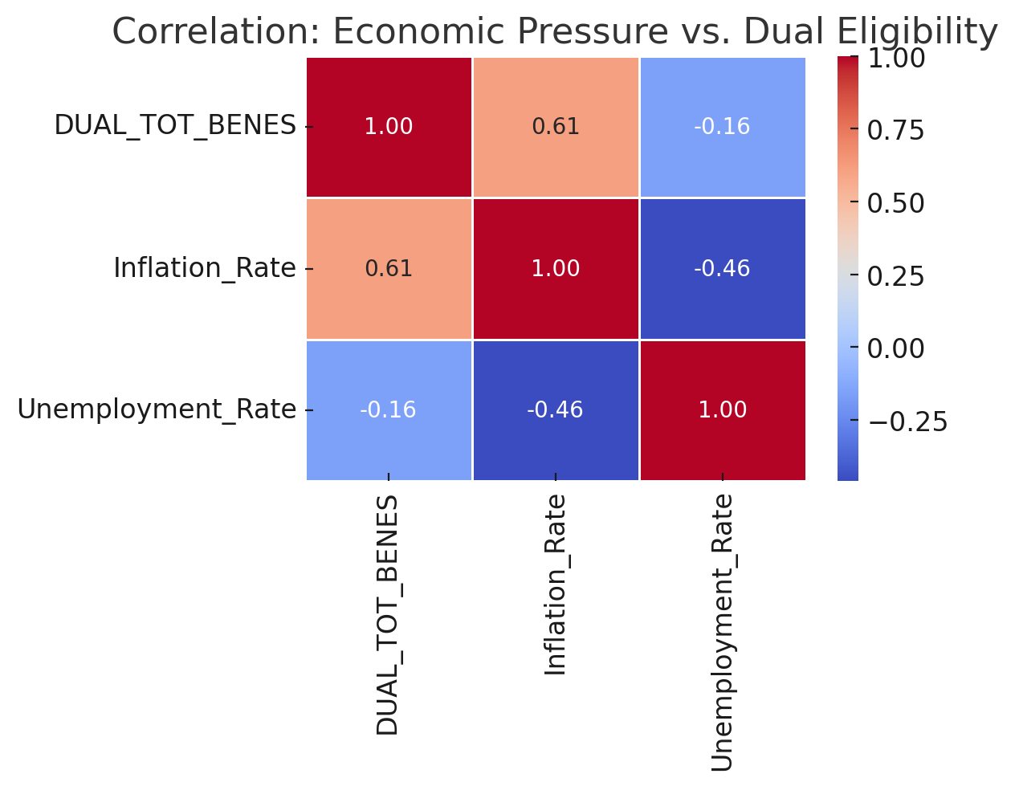
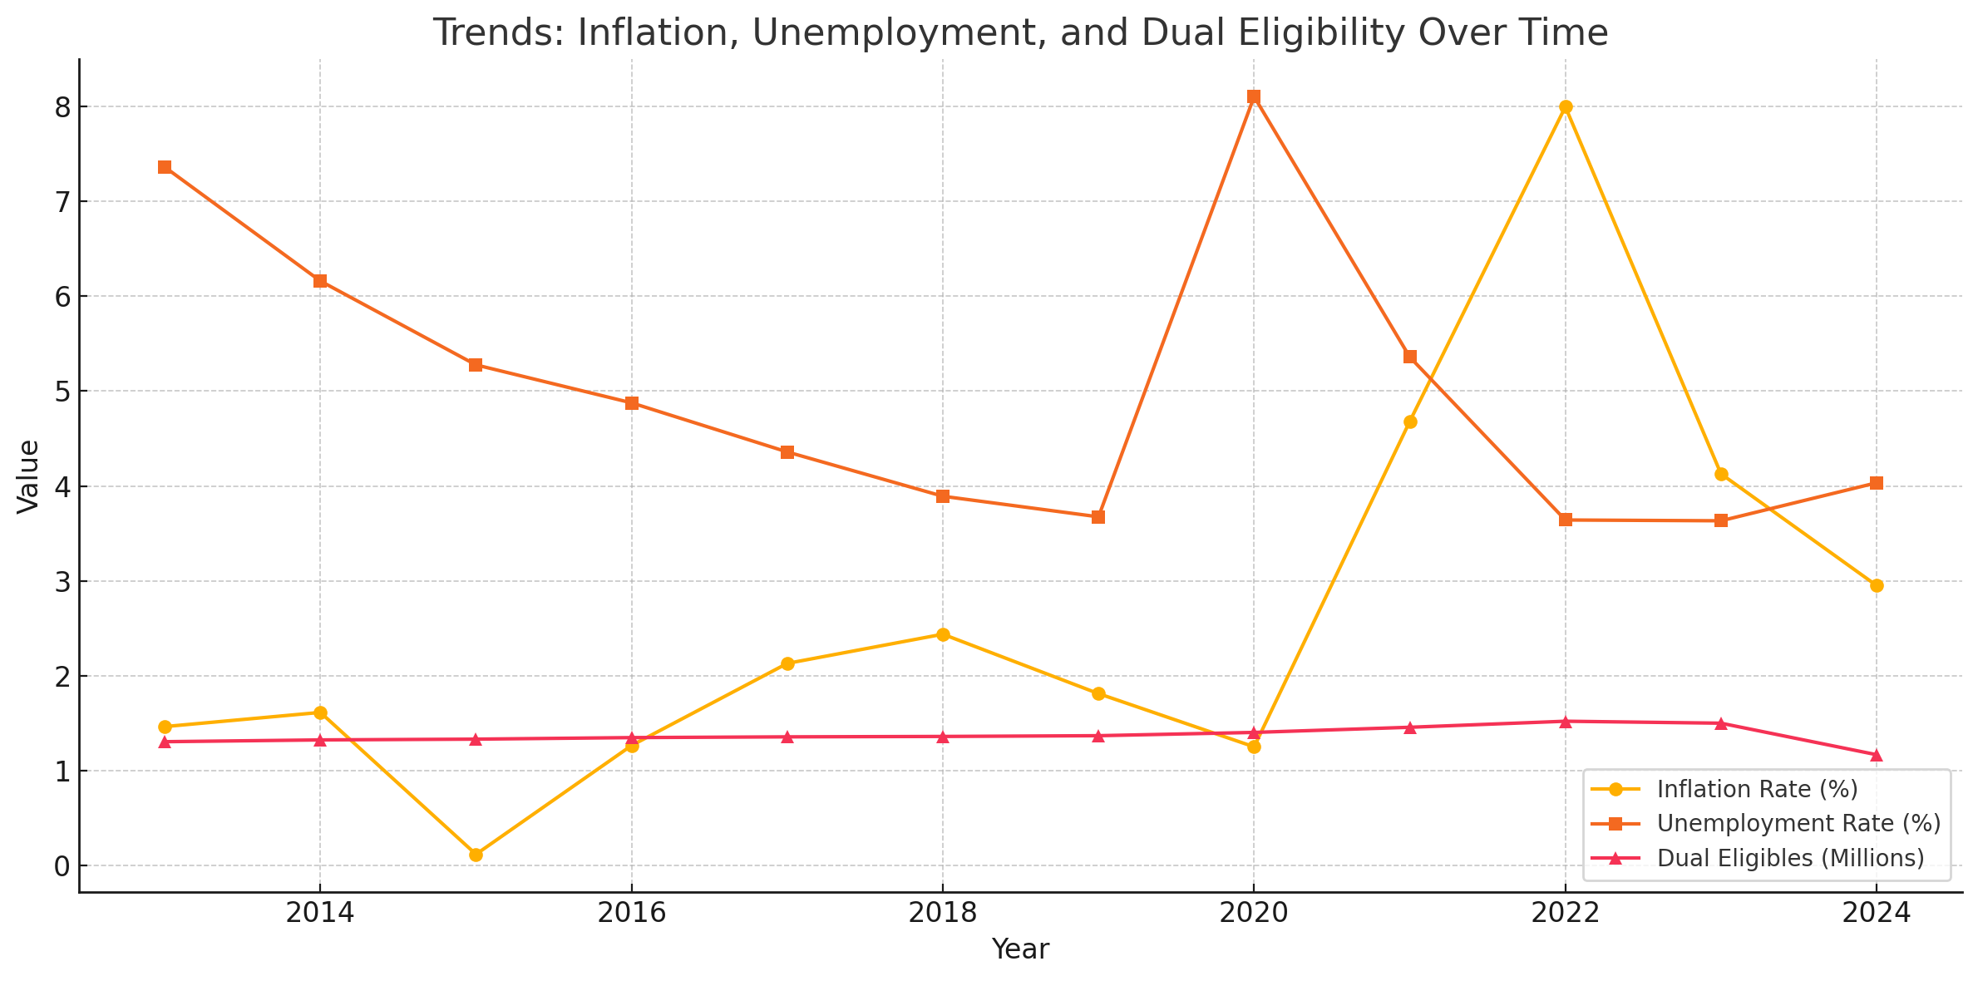
Model job loss/ inflation vs eligibility
Case
Overview
Executive Summary
Data & Methodology
Key Insights
Conclusions
Recommendations
Notes:
The highest peaks in efficiency is lowest in quality and visa versa.

Slide 35
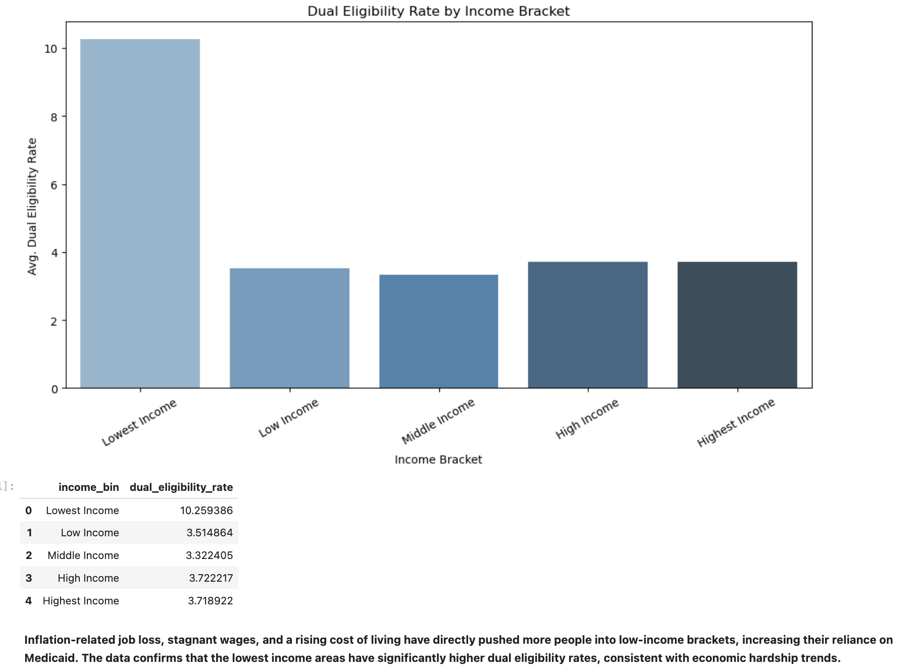
Future Outcome
Case
Overview
Executive Summary
Data & Methodology
Key Insights
Conclusions
Recommendations
Notes:
The highest peaks in efficiency is lowest in quality and visa versa.

Slide 36
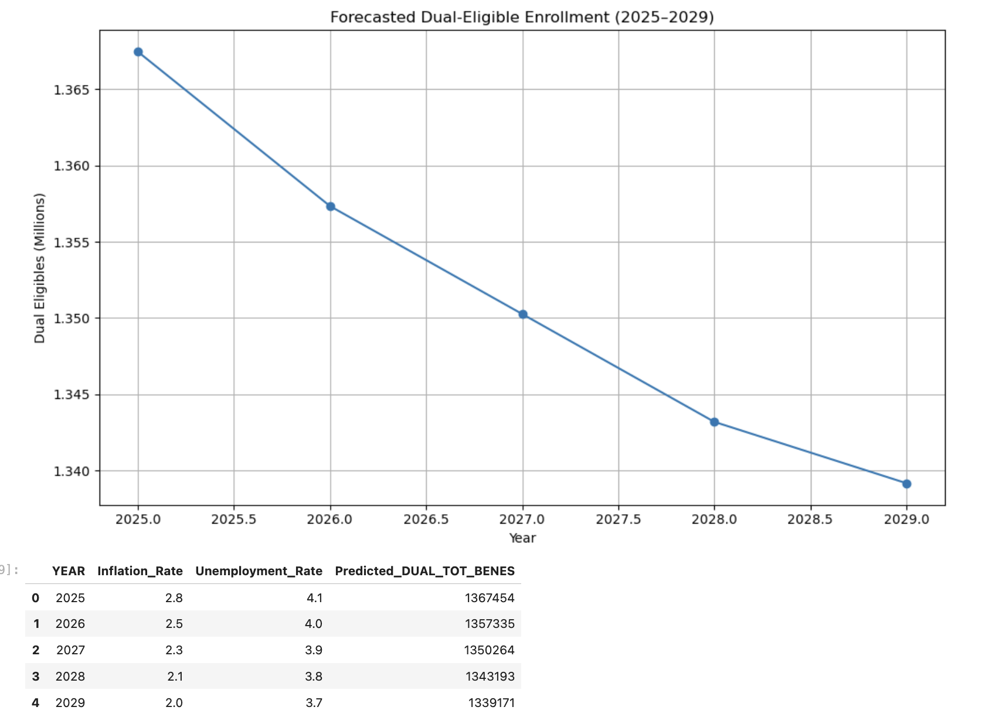
Future Outcome
Case
Overview
Executive Summary
Data & Methodology
Key Insights
Conclusions
Recommendations
Notes:
The highest peaks in efficiency is lowest in quality and visa versa.

Slide 37
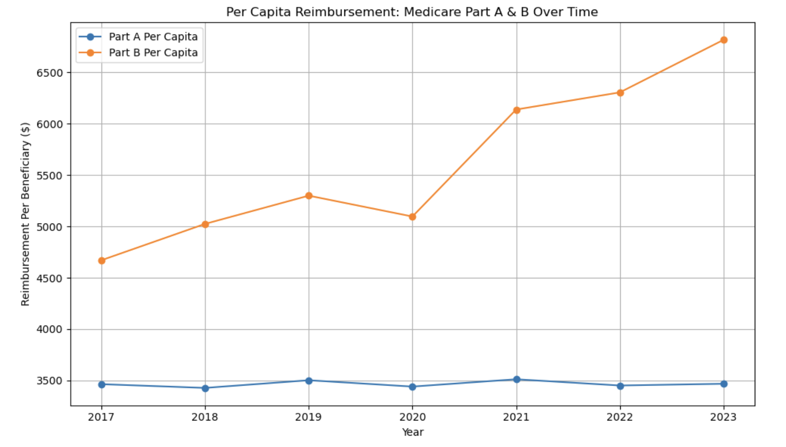
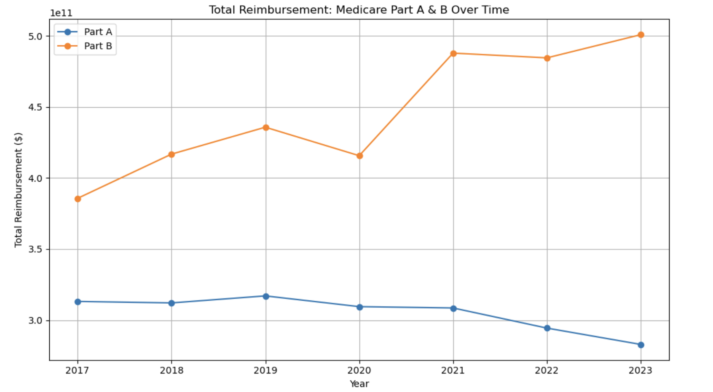
Cost Pressures
Case
Overview
Executive Summary
Data & Methodology
Key Insights
Conclusions
Recommendations
Notes:
The highest peaks in efficiency is lowest in quality and visa versa.

Slide 38
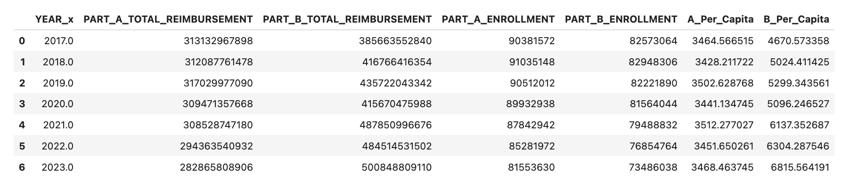
Cost Pressures
Case
Overview
Executive Summary
Data & Methodology
Key Insights
Conclusions
Recommendations
Notes:
The highest peaks in efficiency is lowest in quality and visa versa.

Slide 39
Recommendations

Slide 40

Strategies
For Patient
Enforce Medical Workforce
AI
Rural Telehealth Expansion Kits, offering free tech literacy training
Medication Adherence Rewards
Wellness Program Participation
Gamifying participation in a centralized app
Creating recurring, inter-county branded fitness challenges.
Implement AI-based triage systems, chatbots and predictive analytics for patient flow management.
Data-driven personalization: Tailor health tips, reminders, and care suggestions based on medical history, demographics, and behaviors, promoting a healthy lifestyle.
Monitoring Dashboards with Reinforced Learning
Incentivize Education Offer scholarships, loan forgiveness, and stipends for medical/nursing students who commit to working in rural or underserved areas.
Grow Local Talent
Leverage International Talent
Case
Overview
Executive Summary
Data & Methodology
Key Insights
Conclusions
Recommendations
Notes:
As a results, we suggest to implement human resources strategies which will be focused on creating a positive experience specifically for the areas where we found a significant evidence of making a change. Thus, implementing ideas management tools, change management procedures, enhancing open communication, transparent career pathways and understanding of persanal contibution to the company business goal and using our dashboard for monitoring against the defined trashholds, will allow to improve workforce metrics and as a result, allow possibility for improving efficiency reaching the optimal balance.

Slide 41

Dual Elegibility Dashboard KPIs
Dual Elegibility Metrics
Dual Eligible Count - Total number of dual-eligible members
Dual Eligible Rate (%) - Duals / Total Medicare Beneficiaries
Yearly % Increase of Dual Enrolles by level (zipcode, city, county)
Health Access
Doctor-to-population ratio - Identify workforce shortages
Hospital proximity / count per county - Access to care infrastructure
Socioeconomic Indicators
Median Household Income - From ZIP/county data
College Education Rate (%) - % with college degree or higher
Disabilty Rate (%) - % of population with disability
Uninsured Rate (%) - % without health coverage
Geographic and Cluster metrics
Cluster Assignment - 0–3 based on model
Urban/Rural Flag - Urban vs. rural indicator
Case
Overview
Executive Summary
Data & Methodology
Key Insights
Conclusions
Recommendations
Notes:
These are the alternative models we used. We were looking at how closely each method approaches the ideal outcome for our set of weighted metrics. The highest level of efficiency with minimum possible values of spoilage, quality and safety incidents was shown to be achieved by slsqp that's why we rejected the other two. SLSQP –sequential least squares programming algorithm, limited memory BFGS (parameter estimation in ML), CG –conjugate gradient (numerical solution of particular systems of linear equations, )

Slide 42
Q & A

Slide 43
APPENDIX

Slide 44
Cluster | Counties
0 | Adair (Iowa), Adams (Iowa), Allamakee (Iowa), Appanoose (Iowa), Audubon (Iowa), Aurora (South Dakota), Beadle (South Dakota), Bennett (South Dakota), Benton (Iowa), Bon Homme (South Dakota), Boone (Iowa), Bremer (Iowa), Brookings (South Dakota), Brown (South Dakota), Brule (South Dakota), Buchanan (Iowa), Buena Vista (Iowa), Buffalo (South Dakota), Butler (Iowa), Butte (South Dakota), Calhoun (Iowa), Carroll (Iowa), Cass (Iowa), Cedar (Iowa), Cerro Gordo (Iowa), Charles Mix (South Dakota), Cherokee (Iowa), Chickasaw (Iowa), Clark (South Dakota), Clarke (Iowa), Clay (Iowa), Clay (South Dakota), Clayton (Iowa), Clinton (Iowa), Codington (South Dakota), Corson (South Dakota), Crawford (Iowa), Custer (South Dakota), Dallas (Iowa), Davis (Iowa), Davison (South Dakota), Day (South Dakota), Decatur (Iowa), Delaware (Iowa), Des Moines (Iowa), Deuel (South Dakota), Dewey (South Dakota), Dickinson (Iowa), Douglas (South Dakota), Edmunds (South Dakota), Emmet (Iowa), Fall River (South Dakota), Faulk (South Dakota), Fayette (Iowa), Floyd (Iowa), Franklin (Iowa), Fremont (Iowa), Grant (South Dakota), Greene (Iowa), Gregory (South Dakota), Guthrie (Iowa), Haakon (South Dakota), Hamlin (South Dakota), Hancock (Iowa), Hand (South Dakota), Hanson (South Dakota), Hardin (Iowa), Harding (South Dakota), Harrison (Iowa), Henry (Iowa), Howard (Iowa), Humboldt (Iowa), Hutchinson (South Dakota), Hyde (South Dakota), Ida (Iowa), Iowa (Iowa), Jackson (Iowa), Jackson (South Dakota), Jasper (Iowa), Jefferson (Iowa), Jerauld (South Dakota), Johnson (Iowa), Jones (Iowa), Jones (South Dakota), Keokuk (Iowa), Kingsbury (South Dakota), Kossuth (Iowa), Lake (South Dakota), Lawrence (South Dakota), Lee (Iowa), Louisa (Iowa), Lucas (Iowa), Lyman (South Dakota), Madison (Iowa), Mahaska (Iowa), Marion (Iowa), Marshall (Iowa), Marshall (South Dakota), Meade (South Dakota), Mellette (South Dakota), Mills (Iowa), Miner (South Dakota), Mitchell (Iowa), Monona (Iowa), Monroe (Iowa), Montgomery (Iowa), Moody (South Dakota), Muscatine (Iowa), O'Brien (Iowa), Oglala Lakota (South Dakota), Page (Iowa), Palo Alto (Iowa), Perkins (South Dakota), Plymouth (Iowa), Pocahontas (Iowa), Potter (South Dakota), Poweshiek (Iowa), Ringgold (Iowa), Roberts (South Dakota), Sac (Iowa), Sanborn (South Dakota), Shelby (Iowa), Sioux (Iowa), Spink (South Dakota), Sully (South Dakota), Tama (Iowa), Taylor (Iowa), Todd (South Dakota), Tripp (South Dakota), Turner (South Dakota), Union (Iowa), Union (South Dakota), Van Buren (Iowa), Walworth (South Dakota), Wapello (Iowa), Wayne (Iowa), Webster (Iowa), Winnebago (Iowa), Winneshiek (Iowa), Woodbury (Iowa), Worth (Iowa), Wright (Iowa), Yankton (South Dakota), Ziebach (South Dakota)
1 | Polk (Iowa)
2 | Black Hawk (Iowa), Dubuque (Iowa), Johnson (Iowa), Linn (Iowa), Minnehaha (South Dakota), Pennington (South Dakota), Pottawattamie (Iowa), Scott (Iowa), Woodbury (Iowa)
3 | Adair (Iowa), Adams (Iowa), Allamakee (Iowa), Appanoose (Iowa), Audubon (Iowa), Aurora (South Dakota), Beadle (South Dakota), Benton (Iowa), Bon Homme (South Dakota), Boone (Iowa), Bremer (Iowa), Brookings (South Dakota), Brown (South Dakota), Brule (South Dakota), Buchanan (Iowa), Buena Vista (Iowa), Butler (Iowa), Calhoun (Iowa), Campbell (South Dakota), Carroll (Iowa), Cass (Iowa), Cedar (Iowa), Cerro Gordo (Iowa), Charles Mix (South Dakota), Cherokee (Iowa), Chickasaw (Iowa), Clarke (Iowa), Clay (Iowa), Clay (South Dakota), Clayton (Iowa), Clinton (Iowa), Codington (South Dakota), Corson (South Dakota), Crawford (Iowa), Custer (South Dakota), Dallas (Iowa), Davis (Iowa), Davison (South Dakota), Day (South Dakota), Decatur (Iowa), Delaware (Iowa), Des Moines (Iowa), Deuel (South Dakota), Dickinson (Iowa), Edmunds (South Dakota), Emmet (Iowa), Fall River (South Dakota), Faulk (South Dakota), Fayette (Iowa), Floyd (Iowa), Franklin (Iowa), Fremont (Iowa), Grant (South Dakota), Greene (Iowa), Grundy (Iowa), Guthrie (Iowa), Hamilton (Iowa), Hamlin (South Dakota), Hancock (Iowa), Hand (South Dakota), Hanson (South Dakota), Hardin (Iowa), Harrison (Iowa), Henry (Iowa), Howard (Iowa), Hughes (South Dakota), Humboldt (Iowa), Hutchinson (South Dakota), Hyde (South Dakota), Ida (Iowa), Iowa (Iowa), Jackson (Iowa), Jackson (South Dakota), Jasper (Iowa), Jefferson (Iowa), Jones (Iowa), Jones (South Dakota), Keokuk (Iowa), Kingsbury (South Dakota), Kossuth (Iowa), Lake (South Dakota), Lawrence (South Dakota), Lee (Iowa), Lincoln (South Dakota), Louisa (Iowa), Lucas (Iowa), Lyman (South Dakota), Lyon (Iowa), Madison (Iowa), Mahaska (Iowa), Marion (Iowa), Marshall (Iowa), Marshall (South Dakota), Meade (South Dakota), Mills (Iowa), Miner (South Dakota), Mitchell (Iowa), Monona (Iowa), Monroe (Iowa), Montgomery (Iowa), Moody (South Dakota), Muscatine (Iowa), O'Brien (Iowa), Osceola (Iowa), Page (Iowa), Palo Alto (Iowa), Perkins (South Dakota), Plymouth (Iowa), Pocahontas (Iowa), Potter (South Dakota), Poweshiek (Iowa), Ringgold (Iowa), Roberts (South Dakota), Sac (Iowa), Shelby (Iowa), Sioux (Iowa), Spink (South Dakota), Stanley (South Dakota), Story (Iowa), Sully (South Dakota), Tama (Iowa), Taylor (Iowa), Tripp (South Dakota), Turner (South Dakota), Union (Iowa), Union (South Dakota), Van Buren (Iowa), Walworth (South Dakota), Wapello (Iowa), Warren (Iowa), Washington (Iowa), Wayne (Iowa), Webster (Iowa), Winnebago (Iowa), Winneshiek (Iowa), Worth (Iowa), Wright (Iowa), Yankton (South Dakota)

Slide 45
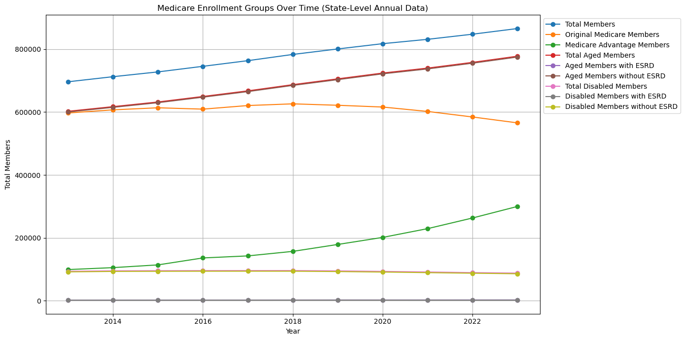
Geographic & Sociographic Trends in Dual Eligibility
Medicare Enrollment Over Time
Case
Overview
Executive Summary
Data & Methodology
Key Insights
Conclusions
Recommendations
Notes:
The highest peaks in efficiency is lowest in quality and visa versa.

Slide 46
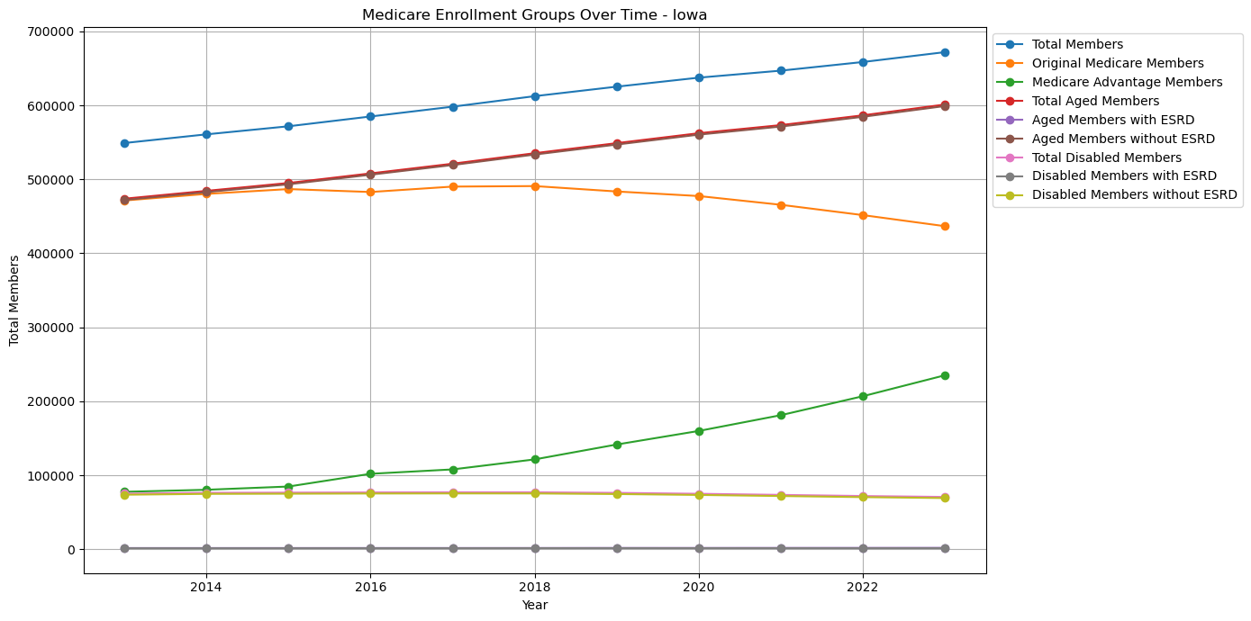
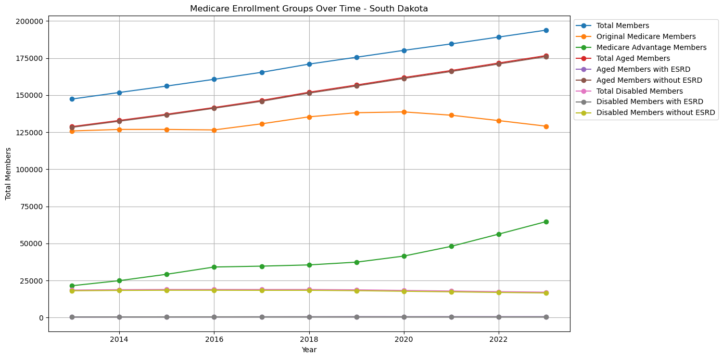
Geographic & Sociographic Trends in Dual Eligibility
Iowa
South Dakota
Case
Overview
Executive Summary
Data & Methodology
Key Insights
Conclusions
Recommendations
Notes:
The highest peaks in efficiency is lowest in quality and visa versa.

Slide 47
References
FFS Data (2015-2023) | CMS
https://fred.stlouisfed.org/series/UNRATE
https://fred.stlouisfed.org/series/CPIAUCSL

